Slide 1
Introduction to Statistical Methods
ISM Team

Slide 2
Session 4
(17th Aug 2025)
Baye’s theorem and Naïve Bayes theorem

Slide 3
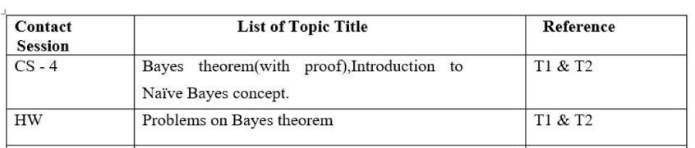
Contact Session 4

Slide 4
Agenda
Baye’s theorem
Problems on Baye’s theorem
Naïve Bayes theorem

Slide 5
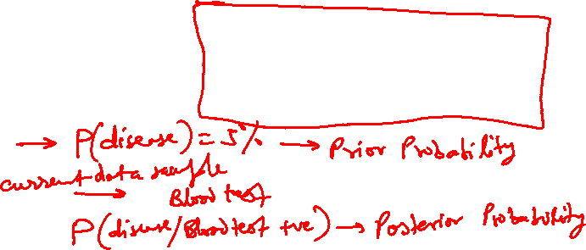
BAYE’S THEOREM:

Slide 6
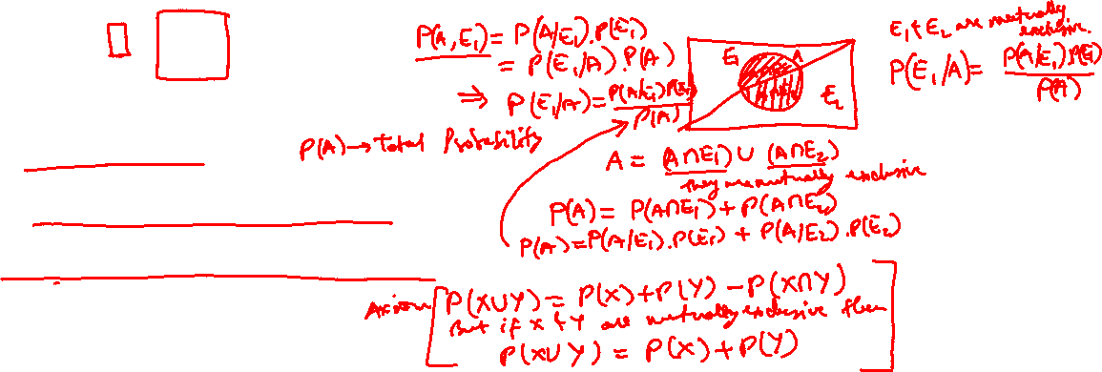
Proof:

Slide 7
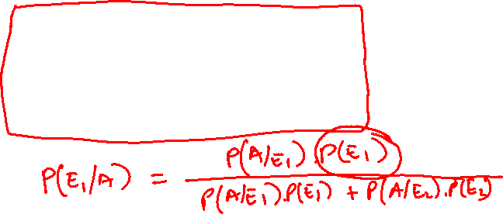
Proof:(continuation)

Slide 8
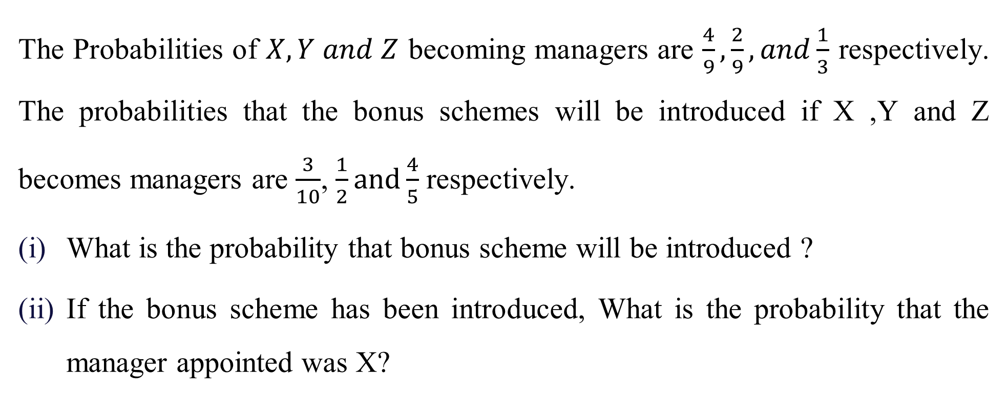
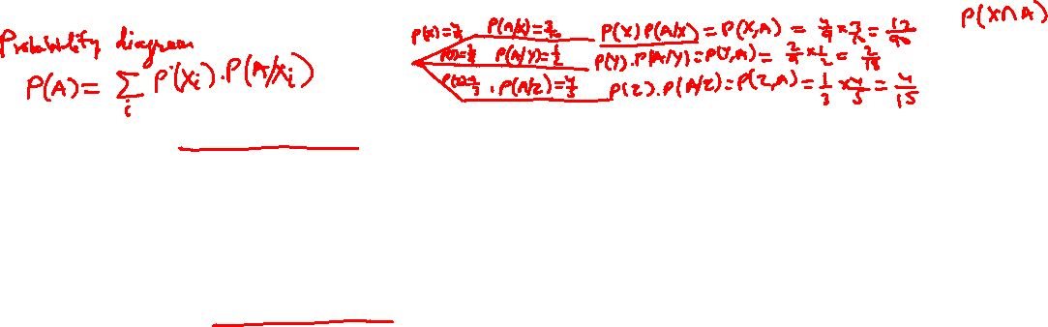
Example:

Slide 9
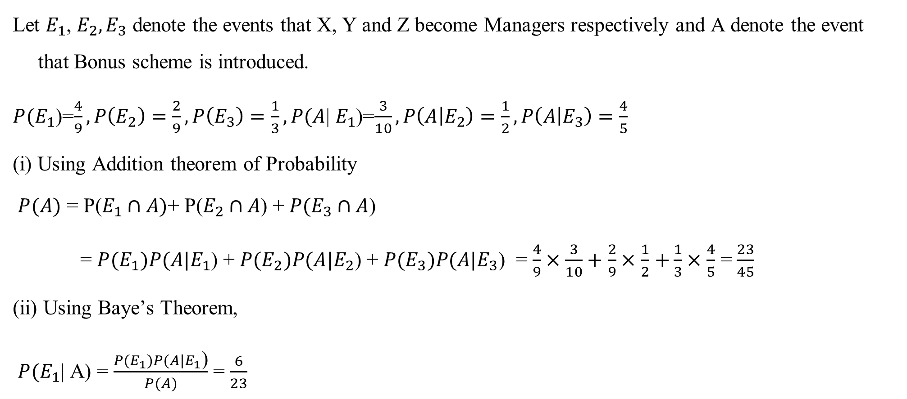

Solution:

Slide 10
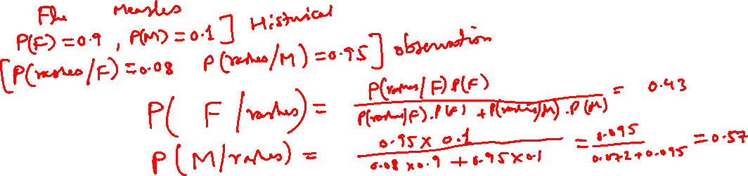
Example:
In a neighborhood, 90% children were falling sick due to flu and 10% due to measles and no other disease.
The probability of observing rashes for measles is 0.95 and for flu is 0.08. If a child develops rashes, Find the child’s probability of having flu.

Slide 11
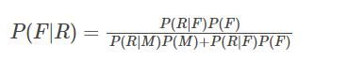
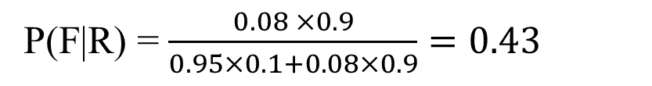
Solution:
Let, F: children with flu M: children with measles
R: children showing the symptom of rash
P(F) = 90% = 0.9, P(M) = 10% = 0.1
P(R|F) = 0.08, P(R|M) = 0.95

Slide 12
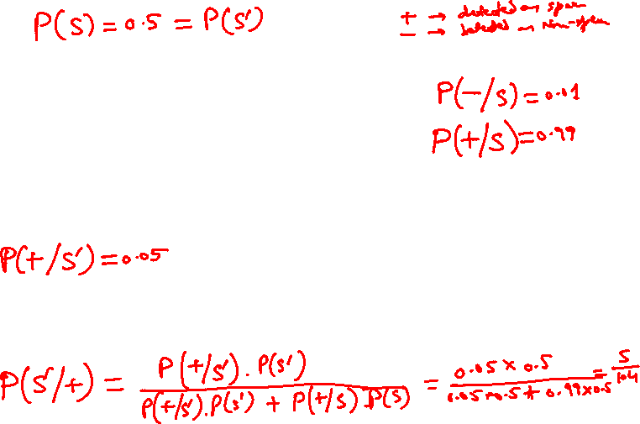
Example
It is estimated that 50% of emails are spam emails. Some software has been applied to filter these spam emails before they reach your inbox.
A certain brand of software claims that it can detect 99% of spam e-mails, and the probability for a false positive (a non-spam email detected as spam) is 5%.
Now if an email is detected as spam, then what is the probability that it is in fact a non-spam email?

Slide 13
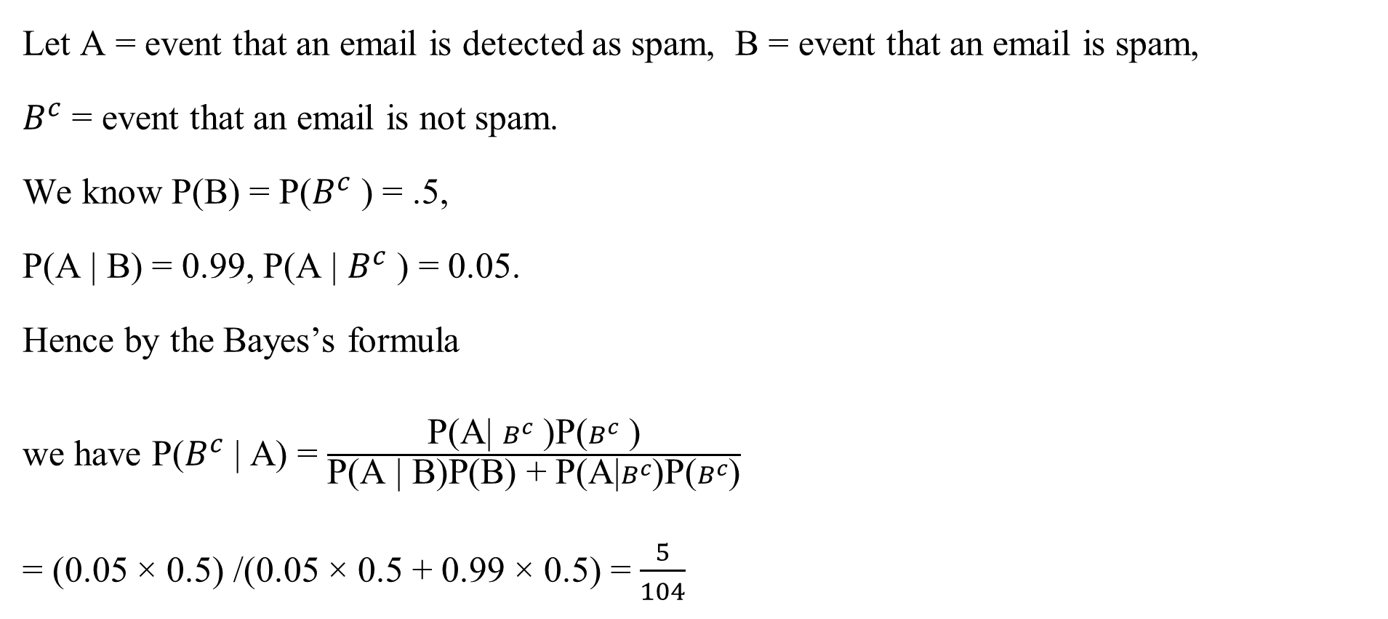
Solution:

Slide 14
Example:
Weather | Play
Sunny | No
Overcast | Yes
Rainy | Yes
Sunny | Yes
Sunny | Yes
Overcast | Yes
Rainy | No
Rainy | No
Sunny | Yes
Rainy | Yes
Sunny | No
Overcast | Yes
Overcast | Yes
Rainy | No
If the weather is sunny, Then the player will play or not?
i.e., Play /sunny = Yes or No.
Note: If we know P(Yes/Sunny) and P(No/Sunny) then we can answer the question asked

Slide 15
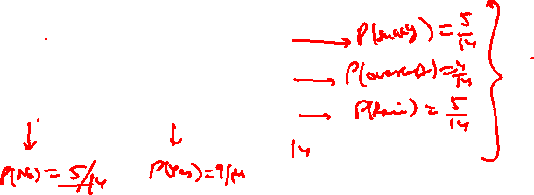
Solution
Convert long data into frequency table
Row and Column sums to get Probabilities
Weather Probabilities:
Sunny =5/14,Rainy=5/14,Overcast= 4/14
Play Probabilities :No =5/14
Yes =9/14
Weather | No | Yes
Sunny | 2 | 3
Overcast | 0 | 4
Rainy | 3 | 2

Slide 16
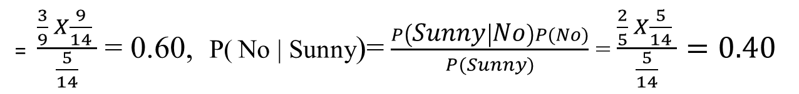
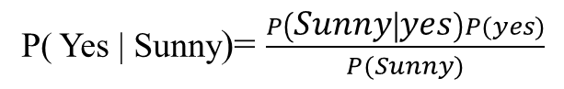
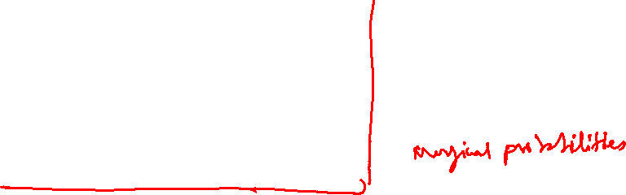
continuation
Weather | No | Yes | Row Total
Sunny | 2 | 3 | 5 | P(sunny)= 5/14
Overcast | 0 | 4 | 4 | P(overcast)=4/14
Rainy | 3 | 2 | 5 | P(Rainy)= 5/14
Column Total | 5 | 9 | 14
 | P(no)=5/14 | P(yes)=9/14
Apply Probabilities from frequency table to Bayes Theorem
P( Yes | Sunny) > P( No | Sunny) . Hence, The Player will play the game.

Slide 17
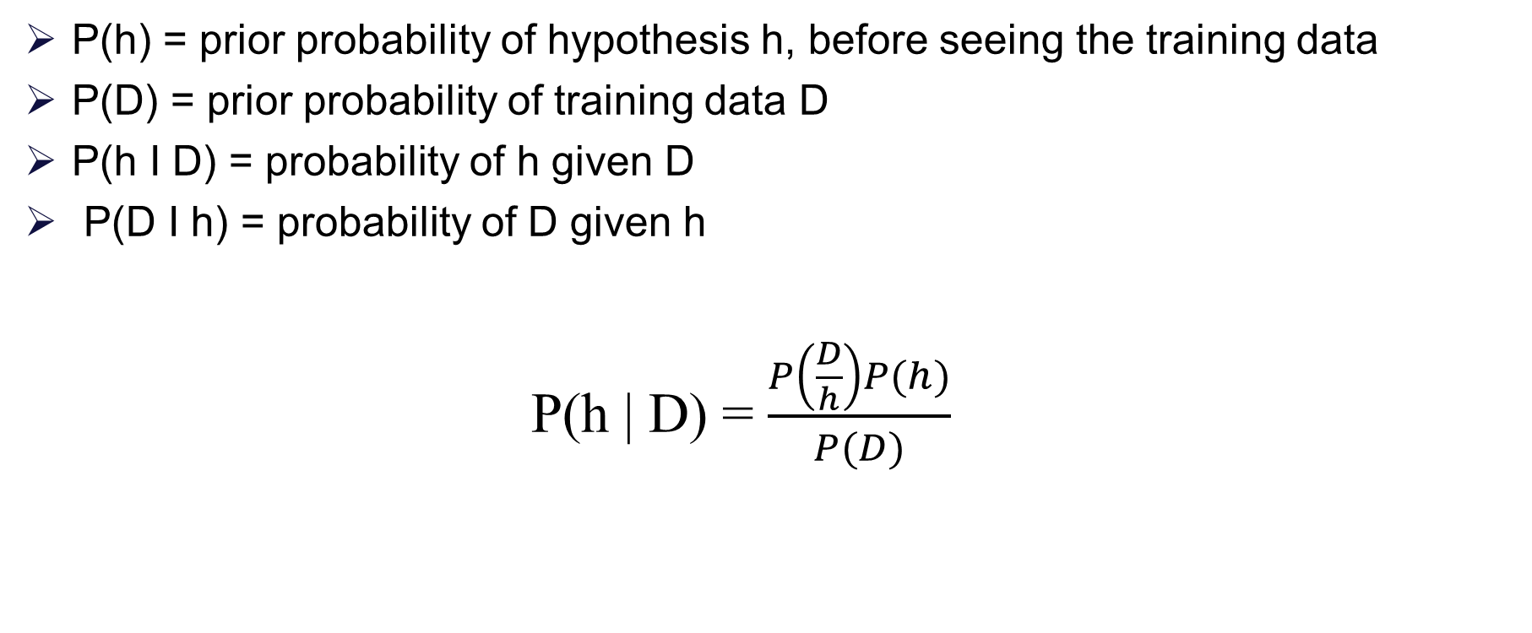
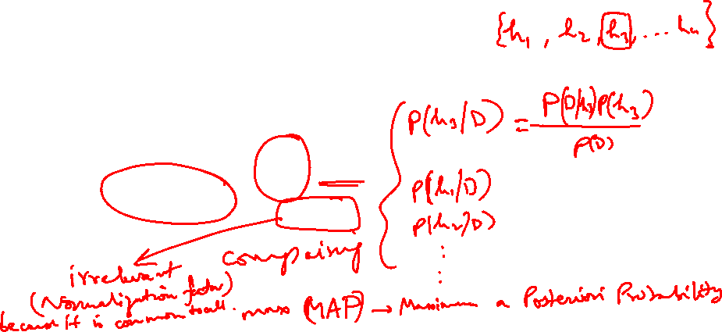
Baye’s Theorem

Slide 18
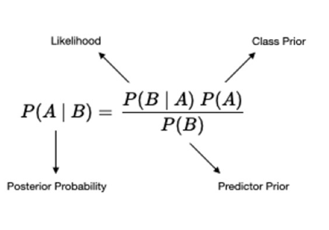
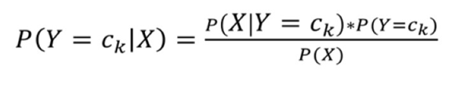
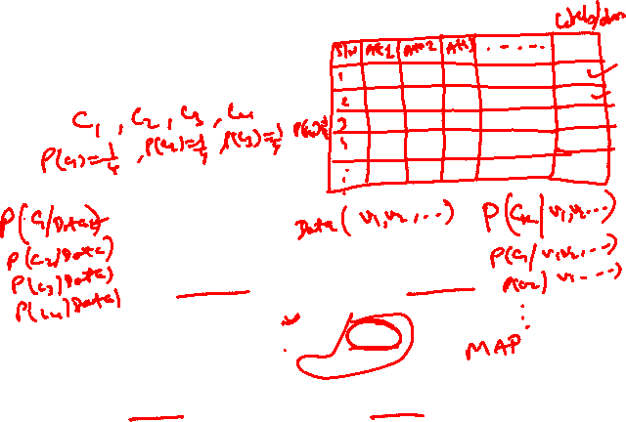
Generative Model
Build model to estimate the posterior probability P(Y | X) by estimating
likelihood of data given target (hypothesis) P(X | Y)
Prior probabilities over target P(Y)
In general, for a specific class Y=ck,

Slide 19
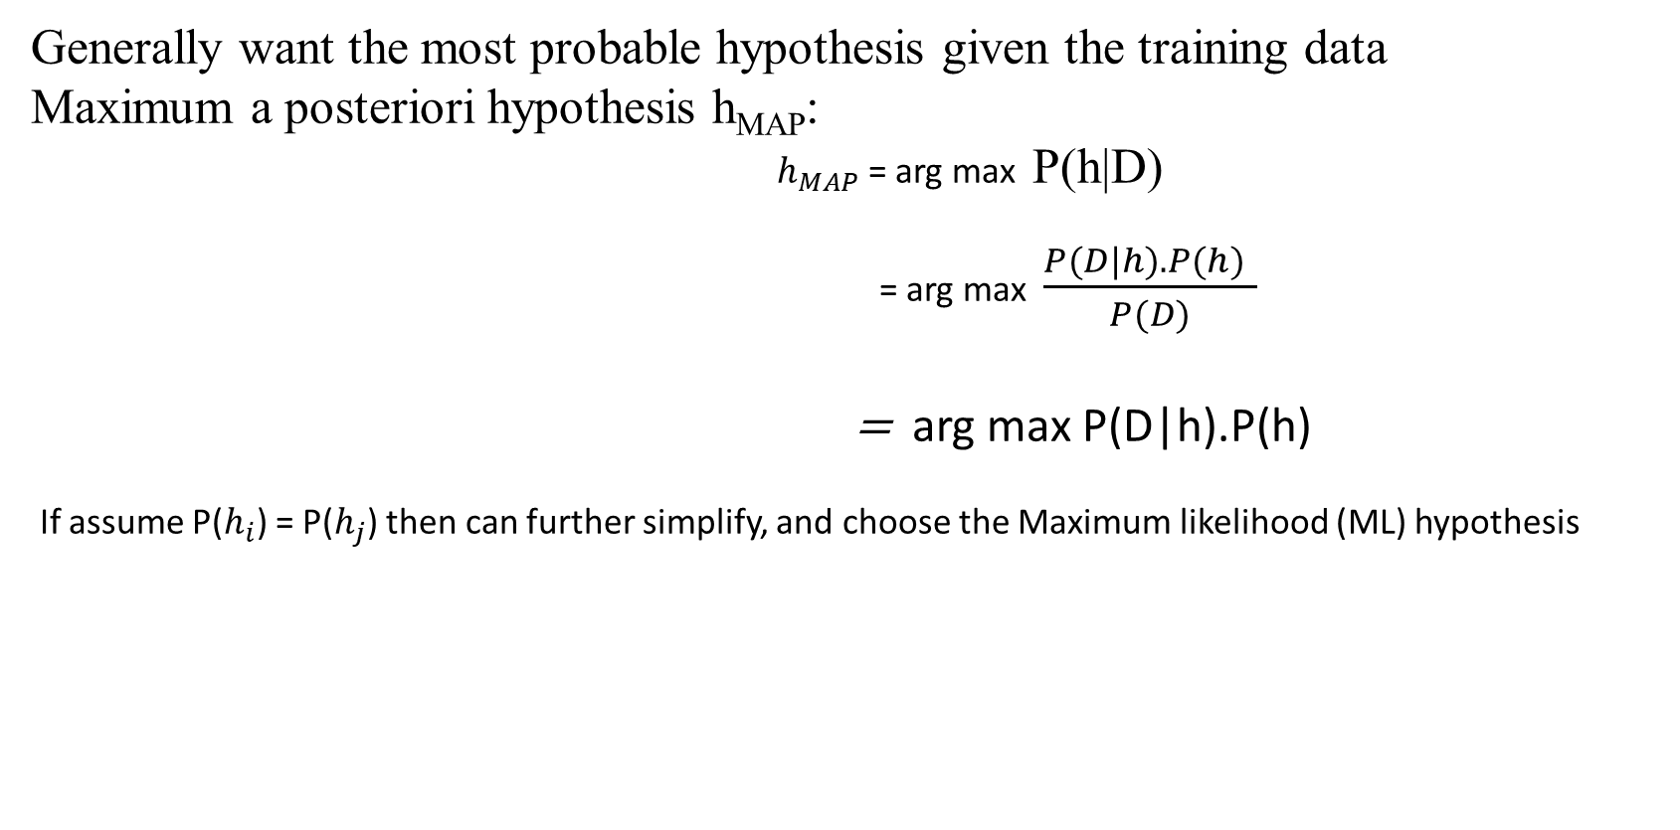
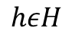
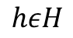
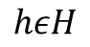
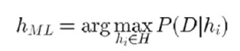
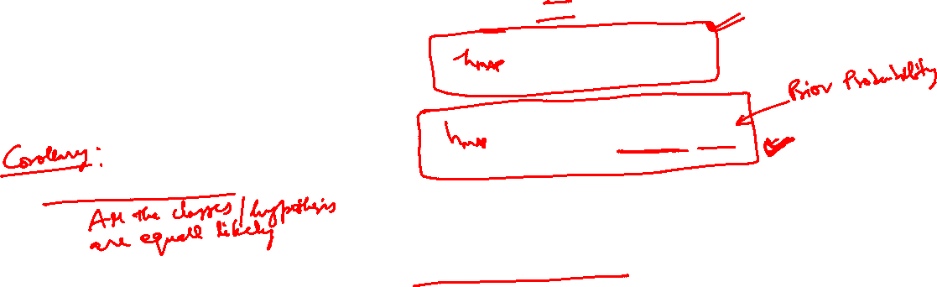
Choosing hypothesis

Slide 20
Bayesian Learning
Naive Bayes is a set of simple and efficient machine learning algorithms for solving a variety of classification and regression problems.
Naive Bayes assumes conditional independence where Bayes theorem does not. This means the relationship between all input features are independent.
Bayesian learning algorithms that calculate explicit probabilities for hypotheses, such as the Naive Bayes classifier, are among the most practical approaches to certain types of learning problems.
Problem of learning to classify text documents such as electronic news articles.
For such learning tasks, the Naive Bayes classifier is among the most effective known algorithms.
Example:

Slide 21
Features of Bayesian learning
Prior knowledge can be combined with observed data to determine the final probability of a hypothesis.
Prior knowledge is provided by asserting
prior probability for each candidate hypothesis, and
probability distribution over observed data for each possible hypothesis.
New instances can be classified by combining the predictions of multiple hypothesis, weighted by their probabilities.

Slide 22
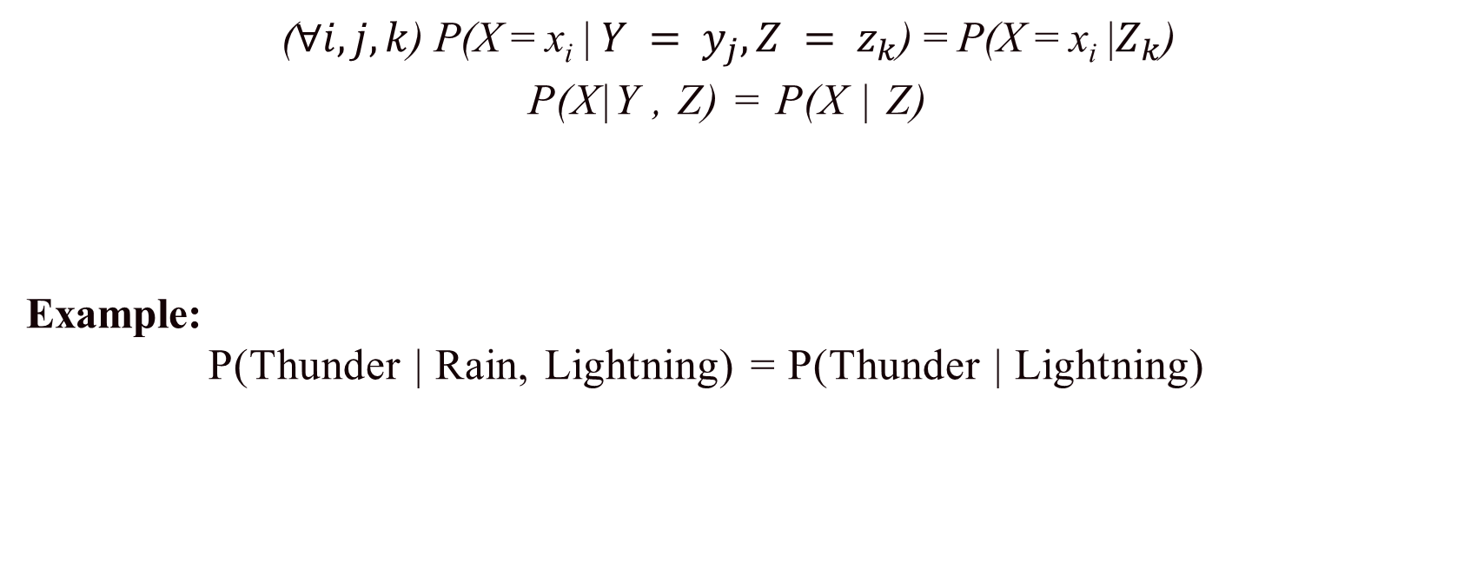
Conditional Independence
Definition: X is conditionally independent of Y given Z, if the probability distribution governing X is independent of the value of Y, given the value of Z

Slide 23
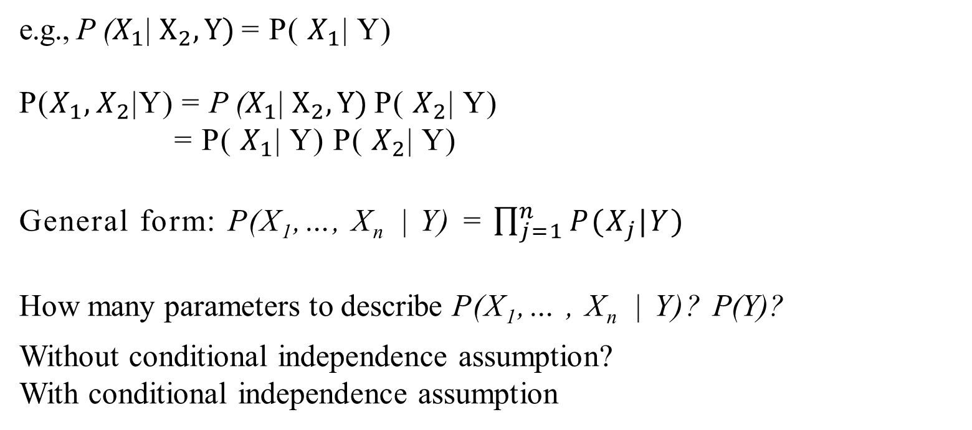
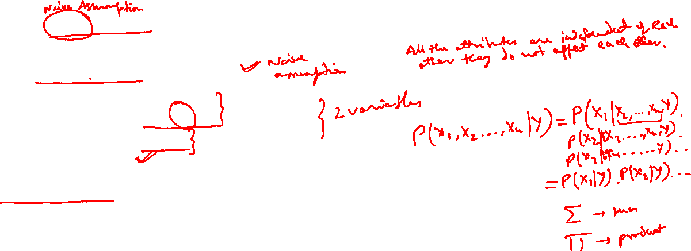
Applying Conditional Independence
Naive Bayes assumes X_{i} are conditionally independent given Y.

Slide 24
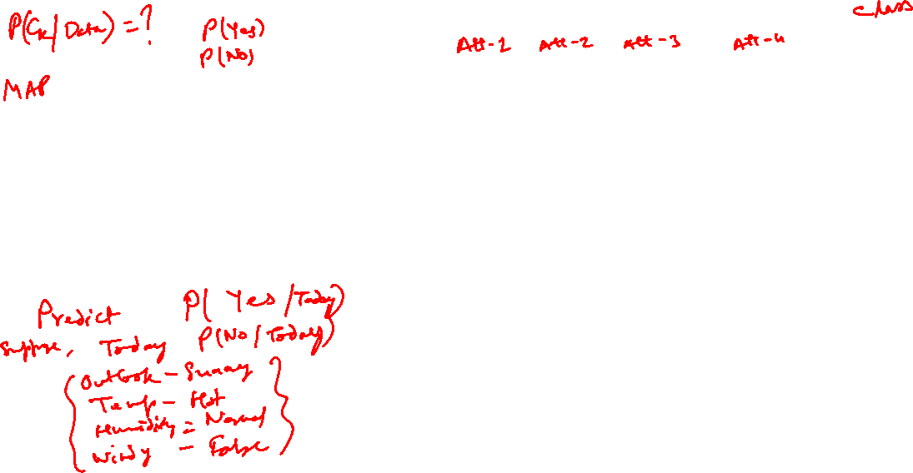
Example
S. No | Outlook | Temp | Humidity | Windy | Play Tennis
1 | Rainy | Hot | High | False | No
2 | Rainy | Hot | High | True | No
3 | Overcast | Hot | High | False | Yes
4 | Sunny | Mild | High | False | Yes
5 | Sunny | Cool | Normal | False | Yes
6 | Sunny | Cool | Normal | True | No
7 | Overcast | Cool | Normal | True | Yes
8 | Rainy | Mild | High | False | No
9 | Rainy | Cool | Normal | False | Yes
10 | Sunny | Mild | Normal | False | Yes
11 | Rainy | Mild | Normal | True | Yes
12 | Overcast | Mild | High | True | Yes
13 | Overcast | Hot | Normal | False | Yes
14 | Sunny | Mild | High | True | No
If the feature of Today = (Outlook is Sunny ,Temp is Hot, Humidity is Normal, Windy is False), then the player will play or not?

Slide 25
Solution:
Outlook | Yes | No
Rainy | 2/9 | 3/5 | 5/14
Overcast | 4/9 | 0/5 | 4/14
Sunny | 3/9 | 2/5 | 5/14
Temp | Yes | No
Hot | 2/9 | 2/5 | 4/14
Mild | 4/9 | 2/5 | 6/14
Cool | 3/9 | 1/5 | 4/14
Humidity | Yes | No
High | 3/9 | 4/5 | 7/14
Normal | 6/9 | 1/5 | 7/14
Windy | Yes | No
True | 3/9 | 3/5 | 6/14
False | 6/9 | 2/5 | 8/14

Slide 26
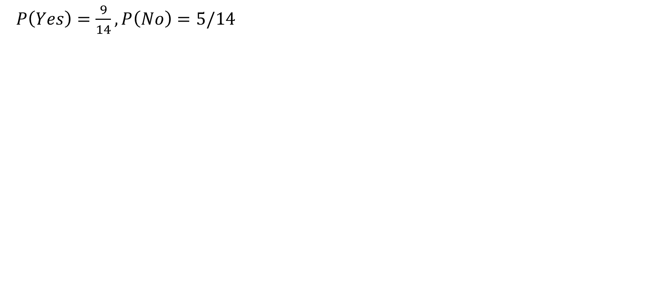
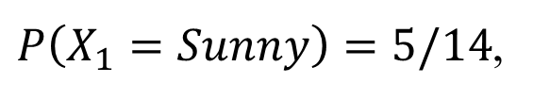
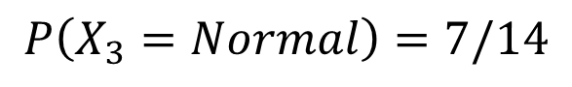
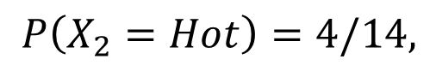
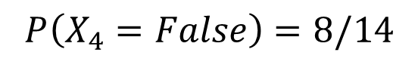
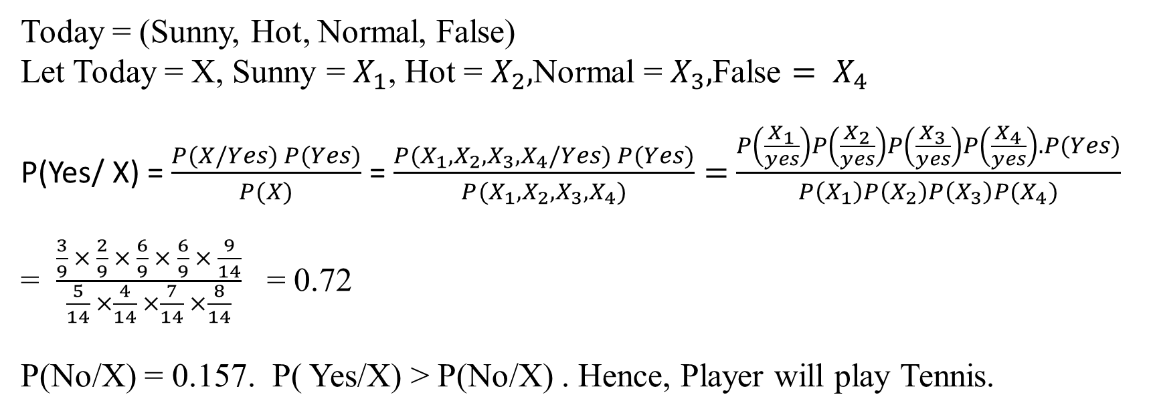
continuation

Slide 27
Example:
(a) Estimate Conditional Probability of each attributes {colour, legs, height, smelly} for the species classes: { S1, S2 } using the data given in the table.
(b) Using these probabilities in the table estimate the probabilities values for the
new instance – { Colour =Green , Legs = 2, Height = Tall and Smelly= No}

Slide 28
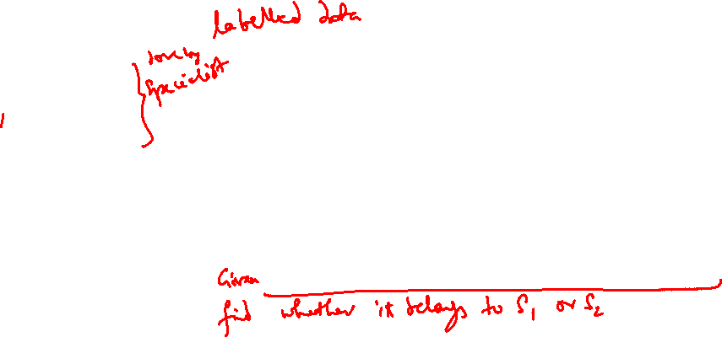
Example:
No | Colour | Legs | Height | Smelly | Species
1 | White | 3 | Short | Yes | S1
2 | Green | 2 | Tall | No | S1
3 | Green | 3 | Short | Yes | S1
4 | White | 3 | Short | Yes | S1
5 | Green | 2 | Short | No | S2
6 | White | 2 | Tall | No | S2
7 | White | 2 | Tall | No | S2
8 | White | 2 | Short | Yes | S2
Estimate Conditional Probability of each attributes {colour, legs, height, smelly} for the species classes: { S1, S2 } using the data given in the table.
Using these probabilities in the table estimate the probabilities values for the new instance –
{Colour =Green , Legs = 2, Height = Tall and Smelly= No}

Slide 29
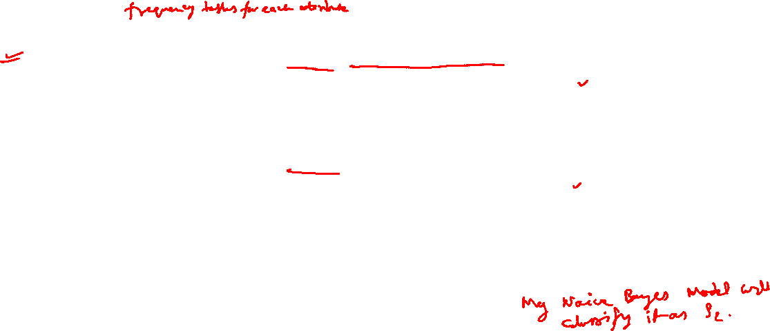
Solution:
new instance(NI) – { Colour =Green , Legs = 2, Height = Tall and Smelly= No}
P(S1/NI)=P(S1).P(S1/Colour=Green).P(S1/Legs=2).P(S1/Height=Tall)P(S1/Smelly= No).
= (1/2).(2/4).(1/4).(3/4).(1/4) = 0.0117
P(S2/NI)=P(S2).P(S2/Colour=Green).P(S2/Legs=2).P(S2/Height=Tall).P(S2/Smelly= No).
= (1/2).(1/4).(4/4).(2/4).(3/4) = 0.047
P(S2/NI) > P(S1/NI)
Hence New Instance belongs to S2
P(S1) = 4/8 , P(S2) = 4/8
Colour | S1 | S2
White | 2/4 | 3/4
Green | 2/4 | 1/4
Height | S1 | S2
Tall | ¾ | 2/4
Short | ¼ | 2/4
Legs | S1 | S2
2 | ¼ | 4/4
3 | ¾ | 0/4
Smelly | S1 | S2
Yes | ¾ | ¼
No | ¼ | 3/4

Slide 30
Issues with Naïve Bayes Classifier
Consider the table with Tid = 7 deleted
Naïve Bayes Classifier:
1.P(Refund = Yes | No) = 2/6
2.P(Refund = No | No) = 4/6
3.P(Refund = Yes | Yes) = 0
4.P(Refund = No | Yes) = 1
5.P(Marital Status = Single | No) = 2/6
6.P(Marital Status = Divorced | No) = 0
7.P(Marital Status = Married | No) = 4/6
8.P(Marital Status = Single | Yes) = 2/3
9.P(Marital Status = Divorced | Yes) = 1/3
10.P(Marital Status = Married | Yes) = 0/3
Given X = (Refund = Yes, Divorced, 120K)
P(X | No) = 2/6 X 0 X 0.0083 = 0
P(X | Yes) = 0 X 1/3 X 1.2 X 10⁻⁹ = 0
Naïve Bayes will not be able to classify X as Yes or No!

Slide 31
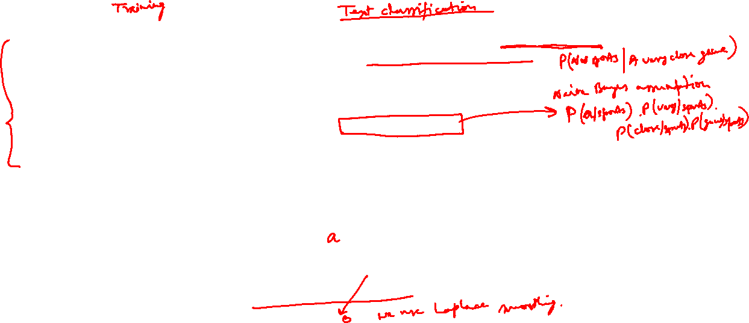
A Simple Example
Text | Tag
“A great game” | Sports
“The election was over” | Not sports
“Very clean match” | Sports
“A clean but forgettable game” | Sports
“It was a close election” | Not sports
Which tag does the sentence A very close game belong to? i.e. P(sports| A very close game)
Using Bayes Theorem:
P(sports| A very close game)
= P(A very close game| sports) P(sports)
----------------------------------------------
P(A very close game)
We assume that every word in a sentence is independent of the other ones
“close” doesn’t appear in sentences of sports tag, So P(close | sports) = 0, which makes product 0

Slide 32
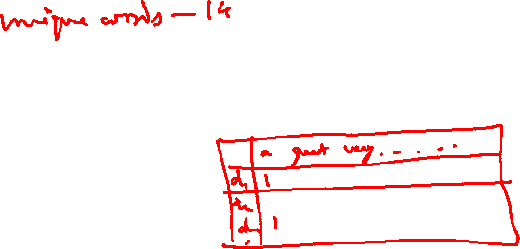
Laplace smoothing
Laplace smoothing: we add 1 or in general constant k to every count so it’s never zero.
To balance this, we add the number of possible words to the divisor, so the division will never be greater than 1
In our case, the possible words are ['a', 'great', 'very', 'over', 'it', 'but', 'game', 'election', 'clean', 'close', 'the', 'was', 'forgettable', 'match'].

Slide 33
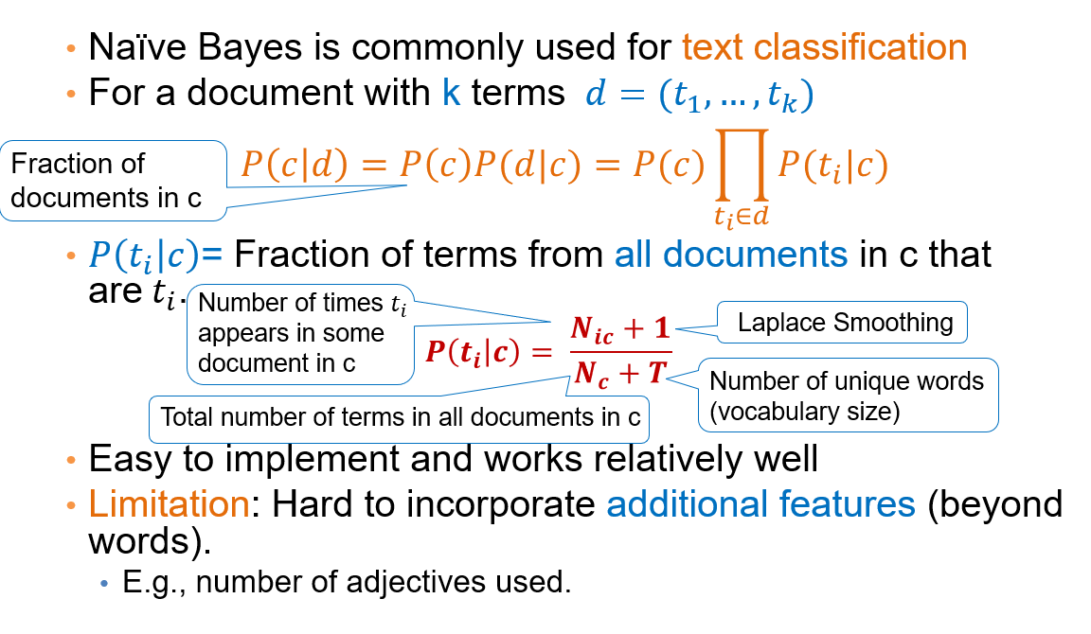

Naïve Bayes for Text Classification

Slide 34
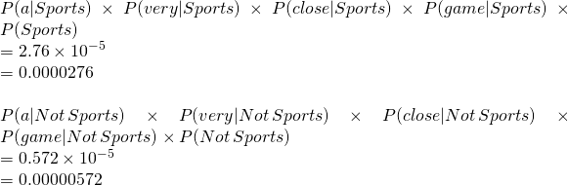
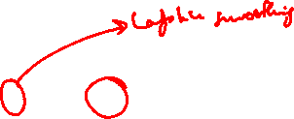
Word | P(word | Sports) | P(word | Not Sports)
a | 2+1 / 11+14 | 1+1 / 9+14
very | 1+1 / 11+14 | 0+1 / 9+14
close | 0+1 / 11+14 | 1+1 / 9+14
game | 2+1 / 11+14 | 0+1 / 9+14

Slide 35
Doc No | Text
1 | I LOVED THE MOVIE _POSITIVE
2 | I HATED THE MOVIE _ NEGATIVE
3 | A GREAT MOVIE ,GOOD MOVIE _POSITIVE
4 | POOR ACTING _NEGATIVE
5 | GREAT ACTING , A GOOD MOVIE _POSITIVE
NEW | I HATED THE POOR ACTING _????

Slide 38
Words | positive | Negative
I | 1 | 1
Loved | 1 | 0
the | 1 | 1
movie | 4 | 1
hated | 0 | 1
a | 2 | 0
great | 2 | 0
poor | 0 | 1
acting | 1 | 1
good | 2 | 0

Slide 41
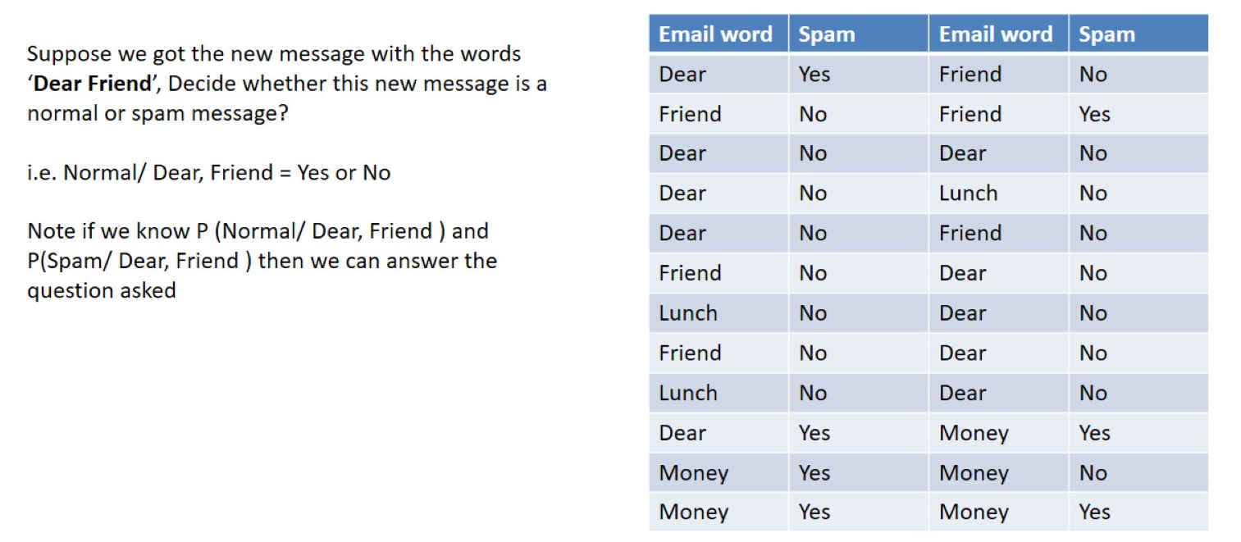
Example

Slide 42
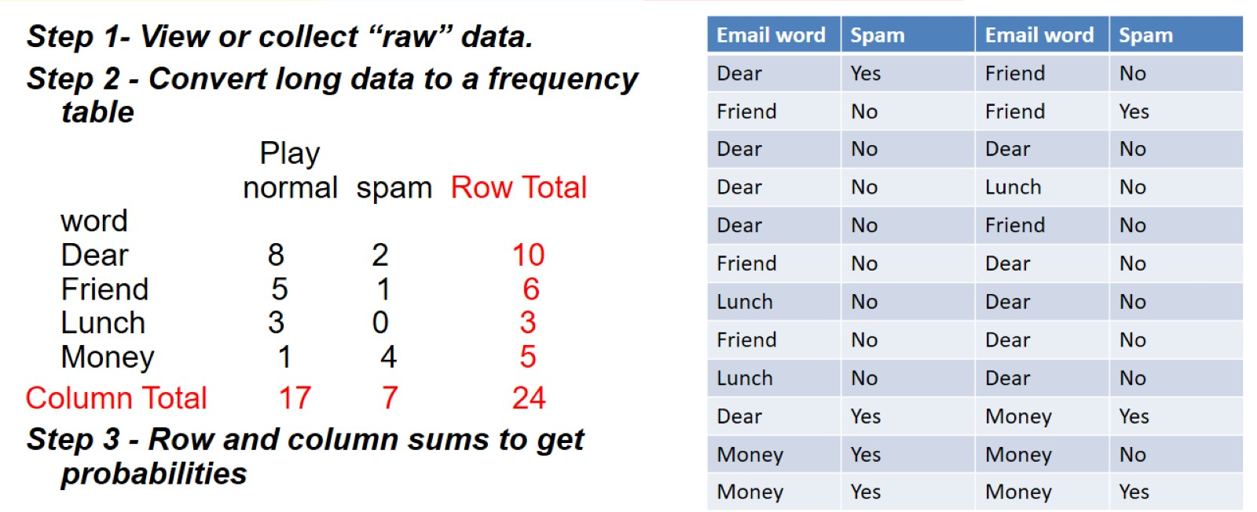
Steps to Apply Bayes Theorem

Slide 43
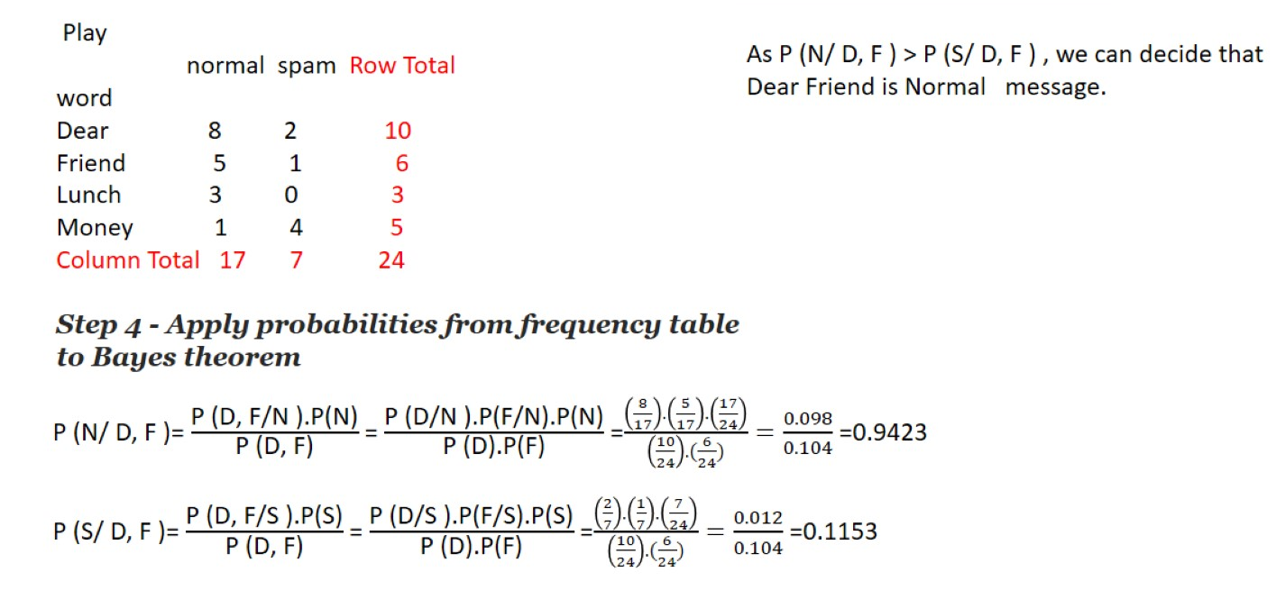
Steps to Apply Bayes Theorem

Slide 44
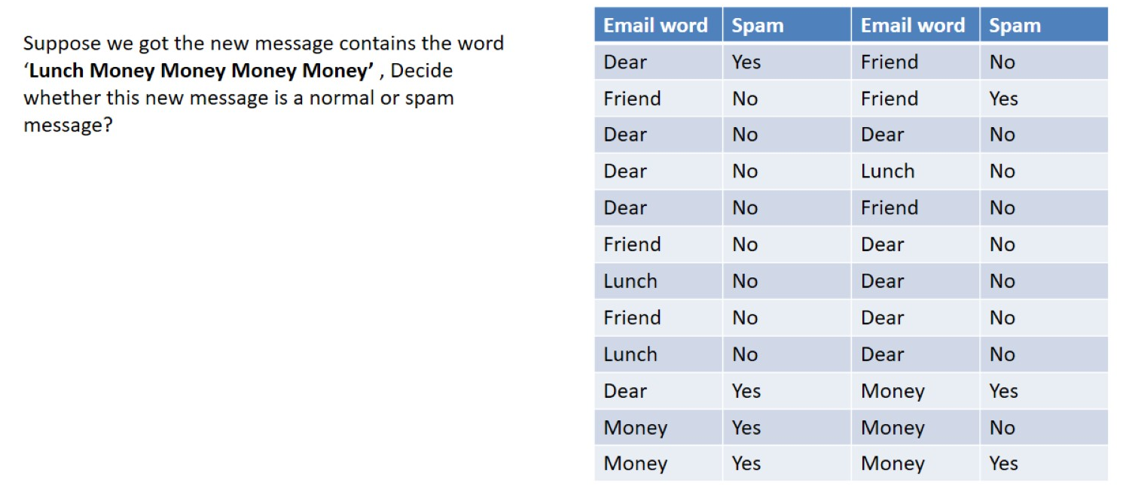
Example continued:

Slide 45
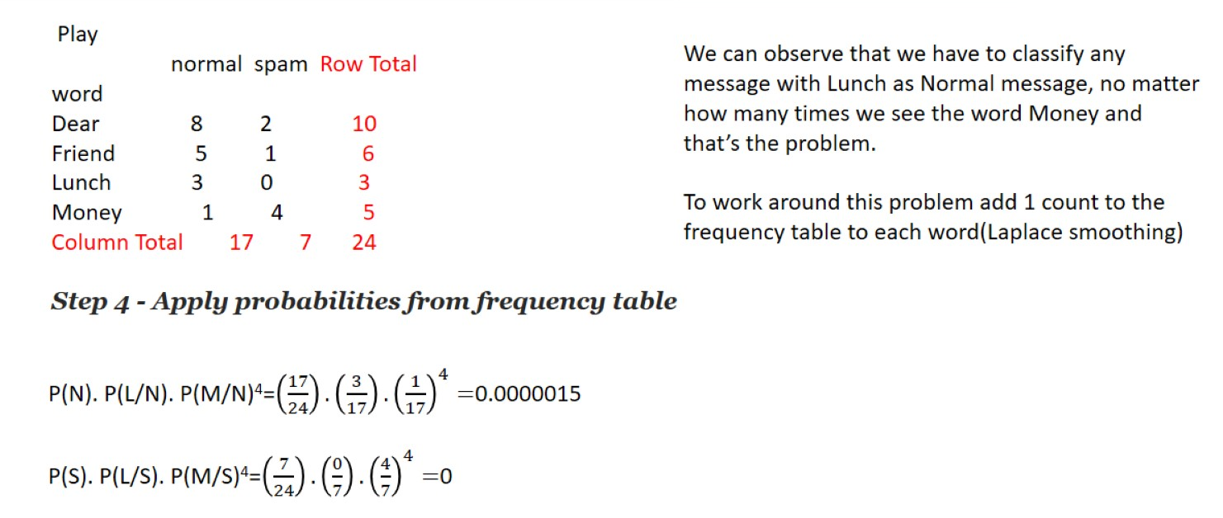
Steps to Apply Bayes Theorem

Slide 46
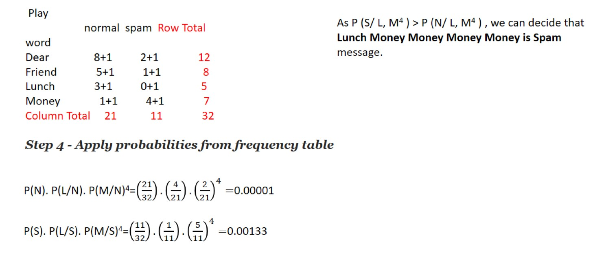
Steps to Apply Bayes Theorem

Slide 47

Naïve Bayes Classifier Applications

Slide 48

Practical Issues of Bayesian learning

Slide 49

Practical Issues of Bayesian learning

Slide 50
Glossary
Conditional probability
Total Probability
Bayes theorem
MAP Hypothesis
ML Estimate
Naïve Bayes theorem
NB with Laplace correction

Slide 51
Practice Problems 1
Two set of candidates are competing for the positions on the board of directors of a
company. The probabilities that the first and the second sets will win are 0.6 and 0.4
respectively. If the first set wins , the probability of introducing a new product is 0.8,
and the corresponding probability if the second set wins is 0.3. What is the probability
that the product will be introduced?

Slide 52

Solution

Slide 53

Practice Problems 2

Slide 54

Solution

Slide 55



Conti..
TREE DIAGRAM
0.05
E
E1
0.25
0.04
0.35
E
0.40
E
0.02
E

Slide 56

Practice Problems 3

Slide 57

Solution

Slide 58


Practice Problems 4
The chances that an academician, a business man and a politician becoming Vice Chancellor of an university are 0.5, 0.3 and 0.2 respectively. The probability that research work will be promoted in the university by these 3 gentlemen are respectively are 0.8, 0.6 and 0.4. It is found Research work has been promoted by the university. What is the chance that an academician has become the VC?
Solution:

Slide 59

Conti..

Slide 60

Practice Problems 5

Slide 61

Solution

Slide 62
Thank You

